Slide 1
Guidance on preparing status update 5
Theme of this presentation is System Validation. Validation is different than testing and different from verification. Verification is conducted typically as a bench test in the lab during development to check if requirements are met. Tests are usually subsystem or integrated subsystem focused.
Validation ensures that the system satisfies requirements, regulations, specifications, and complete cross-conditions of operation for the system. The test planning and execution that we have completed underlies the validation process. System validation is performed on the “full-up” system during or after system integration. System validation is done in real or an accurately simulated environment that system will be operating in.
This update should cover what was accomplished in weeks 9 & 10 and what is planned for weeks 11 and 12 (This period is completion of system test and validation)
Integration should be complete (possibly some reintegration with final PCBs, final ML models, final look/feel for app, etc) Functional system tests, requirements (range) testing, and error testing should be well underway or done.
If you are still doing subsystem bringup and integration, you are putting your project at great risk. You should discuss these scenarios with your TA & prof
This status update should focus on System test and Validation status.

Slide 2
Validation
For validation, we need to move from bench test environment to more realistic lab or actual environment that the system would be deployed in. That means you should have scenarios that you have or will test in the field or in accurately simulated environments – same or representative location, terrain, real or accurately emulated users, physical & environmental condition, etc
Fidelity of prototype should be very high – exact hardware and software that the final system will use, PCBs not breadboards, actual external equipment of systems that your system will interact with. Where prototype level hardware and software is used, it should be reported as such.
We STRONGLY suggest using a scenario-based validation process. Scenarios should be developed, owned by one team member, carried out (may be done by 1 person or may require entire team), and results should be recorded. Scenario results should be presented in your demo and documented in your final report.
  Scenarios are end to end targeted uses of your system that capture the operations of your system that you specified in your con ops (with specifics for operating modes, users, and sequences of actions).
  Scenarios should cover all major normal uses of your system for all modes: eg. system setup/calibration process; use by general user, user by someone with additional responsibility/authority .. Maintainer, auditor, manager,…; maximum demand usage; coverage of operation ranges and environments, etc. Scenarios to show operation to minimum function depending on resource usage or system demand changes.
  Scenarios can be developed to show correct operation for one or more requirements that you specified in your FSR.
  Scenarios should also include operation outside normal operation – incorrect request/actions by a user; failures and disaster recovery scenarios; recover processes;
  May include system lifecycle scenarios – updating a sw/hw component; expanding service or operation; decommissioning the system;

Slide 3


Team 99: Project Name
Bi-Weekly Update 5
Team members list
Sponsor: Sponsor Name
TA: TA Name
Intro should take 30 seconds
Notes:
Michelle

Slide 4
Project Summary (30 sec)
Problem statement:
State/succinctly describe the problem that warrants spending the time, effort, and cost to develop a product or service to address the problem.
Problem statement
Our Solution:
Describe the major contribution of your product that solves/addresses this problem.
Solution summary
Solution summary
Good ENGINEERING figure here…eg plot showing the trend of the problem getting worse, figure showing a failed product, good logo for your product, …
Draw a picture of your proposed solution. Show all the pieces and how they are connected to build the final product. This is NOT the FSR block diagram but a cartoon/picture.
DO NOT show two paragraphs!

Slide 5
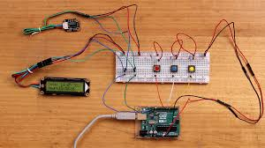
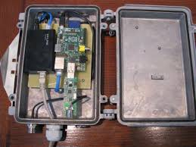
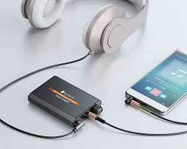
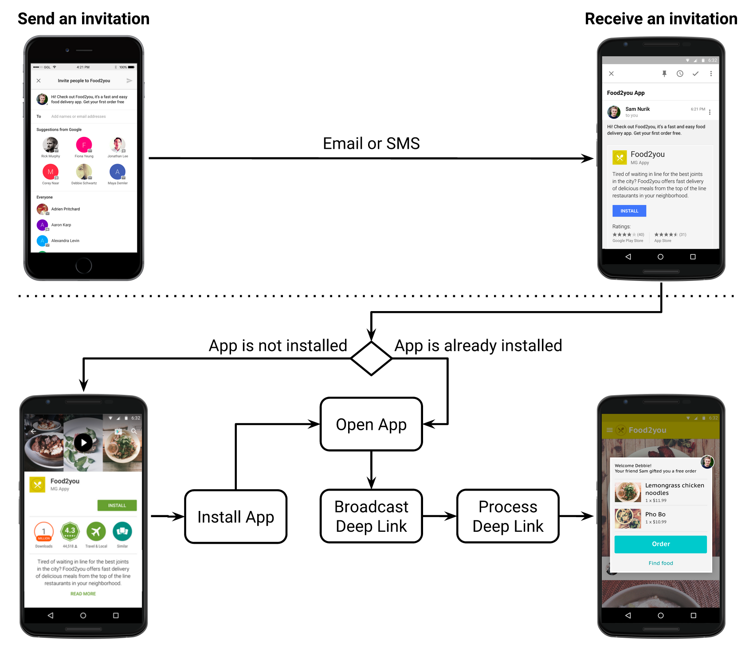
Integrated System Diagram (90 sec)
NOTE this is not your usual system block diagram
This should show the complete system – with picture of packaged solution or conceptual diagram of packaged solution. Use this to describe how user interacts with system and how system interacts with external environment.
Show how it connects to the outside world (communication, interfaces).
If appropriate show internal breakdown and interfaces.
SW projects should show data repository/db; mobile/web app connectivity; front end vs backend; and give representative screens users will see – real look-and-feel
Unacceptable – not integrated
Good – shows enclosure, integrated system. Just label things
Better – Shows packaged amplifier, app for interface, and users headphones
Good – Shows solution with user experience in interacting with SW

Slide 6
Project Timeline (30 sec)
*example
Subsystem Designs and Testing (completed 9/11) | Integration of motor subsystem and MCU (completed 9/17) | Integration of Bluetooth and iPhone App (to complete by 9/28) | Final Integration (to complete by 10/15) | System Test (to complete by 11/2) | Validation (to complete by 11/26) | Demo and Report (to complete by 12/5)
Just quick overview…do not talk about work completed weeks ago, concentrate on past few weeks and upcoming activity
Save discussion for subsystem update
Save detail for execution plan & validation plan status

Slide 7
Name of Subsystem 1 or Integrated System 1 – (45 sec)
Owner(s) Name
This should not be just subsystem status!
At this point it should be review of the System Integration
and Test activities led by Team Member 1
Accomplishments since midterm update XX hrs of effort (You should be putting 7-10 hr/week on capstone!) | Ongoing progress/problems and plans until the next presentation
What has been accomplished since last review (not just started) | What are you currently working on designing, building, debugging, testing AND/OR you are going to accomplish in the next 2 weeks
For 5th review Accomplishments should include system testing and specific validation scenarios results:
“Validated correct system operation for temperatures from 25C to 50C”
“Completed battery lifetime system test for maximum workload and simple workload cases”
“Validated back end database loss and recovery”
“Tested image detection in flight Pi-4 on drone with detection accuracy of XX”
“Validated all app error handling for valve failures”
“ON-GOING 5 day field test of monitoring system”
“Developing validation scenarios for mobile user operating through App and dispatcher functions through web app interface”

Slide 8
Name of Subsystem 1 or Integrated System 1 – (45 s)
Owner(s) Name
This should all be test and validation results! – show things working, functional test results, error checking, etc, what validation is planned using what scenarios
Show test and validation results for integrated systems
Next few slides for each subsystem or integrated system

Slide 9
Execution Plan (45 sec)
Planned milestones for completion of any remaining subsystem functionality, integration of specific subsystems, test, and validation plans should be presented.
Milestones should have owners … things like final integration can be group owned
Gantt chart – should indicate 404 progress.
DO NOT try to discuss all milestones in the plan – just high priority present and next engineering milestones.

Slide 10
SYSTEM Validation Plan (1 minute)
This is not a Gantt chart.
Validation plan is a table showing:
  Name: descriptive short description of what is being validated,
  Requirement: Identifer to link to requirement # from conops/fsr/icd
  Success Criteria for validation – range/lifetime/performance metric/physical limit…that must be met.
  Methodology – test procedure followed/observations made/simulations completed/.. to satisfy the validation
  Responsible party
  Status – complete/not complete

Slide 11
Final Slide
Restate team # and name, thank your audience for their attention, indicate you will take questions
Make modification as needed.
Make slides not too wordy (and more visual) - use keywords, bullet points, short phrases, no full sentences, etc.
Remove instructions the audience is not supposed to see, of course.
Pay attention to readability and consistency in formats throughout the slides.

